Slide 1
Lecture 5 – Evolutionary Algorithms I
COMP2001/2011: Artificial Intelligence Methods
Prof Ender Ozcan

Slide 2

Learning Outcomes
Be able to identify population-based metaheuristics
Understand the underlying analogy for Evolutionary Algorithms
Be able to identify different types of Evolutionary Algorithms
Understand the basic components of Genetic Algorithms as well as Memetic Algorithms, including mutation, crossover, parent/mate selection, replacement, and how each operates – learning the jargon
Be able to design and apply a Genetic/Memetic Algorithm to an “unseen” problem

Slide 3
Outline
Analogy of Evolution
Evolutionary Algorithms
Genetic Algorithms (GAs)
Memetic Algorithms (MAs)

Slide 4
Evolutionary Algorithms
Evolutionary is Revolutionary

Slide 5
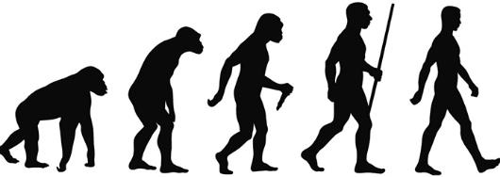
Evolutionary is Revolutionary
Nature as a Problem Solver: 4.55 Billion years of evolution can’t be wrong.
Beauty-of-nature argument: Complexity achieved in short time in nature.
Can we solve complex problems as quickly and reliably on a computer?
Nature as a Problem Solver: 4.55 Billion years of evolution can’t be wrong.
Beauty-of-nature argument: Complexity achieved in short time in nature.
Can we solve complex problems as quickly and reliably on a computer?
Evolution: Gradual change in the inherited characteristics of a population of animals or plants over successive generations

Slide 6
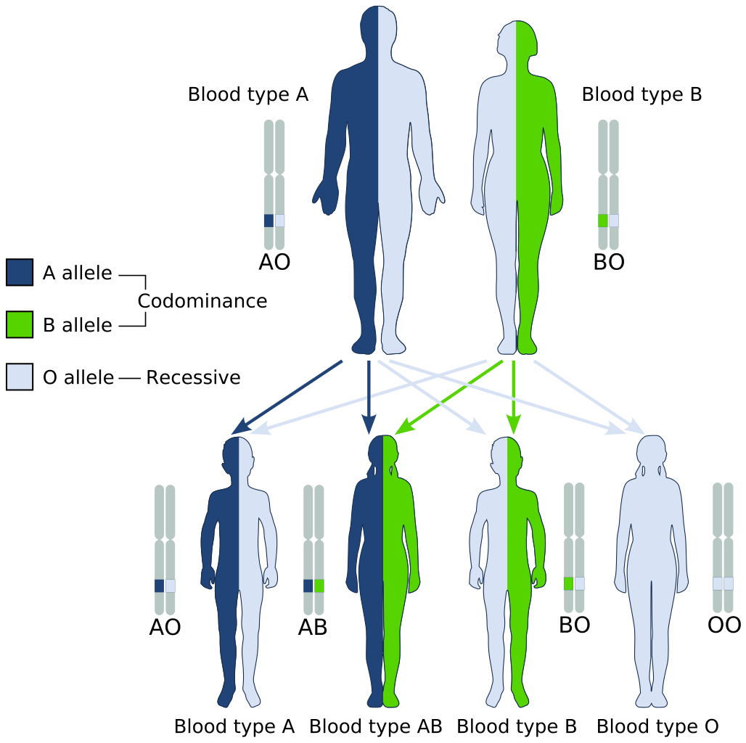
Evolution at Work
Heritable characteristics or heritable traits, e.g., the blood types are passed from one generation to the next via DNA (a molecule that encodes genetic information)
Change or genetic variation comes from:
Mutations: changes in the DNA sequence,
Crossover: reshuffling of genes through sexual reproduction and migration between populations
Evolution is driven by natural selection – survival of the fittest
Genetic variations that enhance survival and reproduction become and remain more common in successive generations of a population
Heritable characteristics or heritable traits, e.g., the blood types are passed from one generation to the next via DNA (a molecule that encodes genetic information)
Change or genetic variation comes from:
Mutations: changes in the DNA sequence,
Crossover: reshuffling of genes through sexual reproduction and migration between populations
Evolution is driven by natural selection – survival of the fittest
Genetic variations that enhance survival and reproduction become and remain more common in successive generations of a population

Slide 7
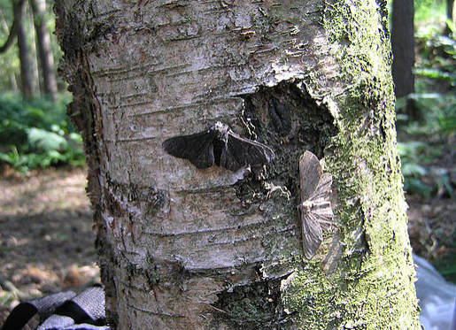

A famous example – peppered moth evolution
white/black-bodied peppered moth
Before the Industrial Revolution, the black peppered moth was rare.
The frequency of the dark allele was about 0.01%
The rapid industrialisation and rampant coal use coated the British trees in a layer of soot
By the mid-19th century, the number of dark-coloured moths had risen noticeably, and by 1895, the frequency was 98% in Manchester
Before the Industrial Revolution, the black peppered moth was rare.
The frequency of the dark allele was about 0.01%
The rapid industrialisation and rampant coal use coated the British trees in a layer of soot
By the mid-19th century, the number of dark-coloured moths had risen noticeably, and by 1895, the frequency was 98% in Manchester

Slide 8
Evolutionary Algorithms (EAs)
EAs simulate natural evolution (Darwinian Evolution) of individual structures at the genetic level using the idea of survival of the fittest via processes of selection, mutation, and reproduction (recombination)
An individual (chromosome) represents a candidate solution for the problem at hand. (e.g., <2 1 3 4>)
A collection of individuals currently “alive”, called population (set of individuals/chromosomes) is evolved from one generation (iteration) to another depending on the fitness of individuals in a given environment, indicating how fit an individual is, (how close it is to the optimal solution) – objective value. (e.g., f(<2 1 3 4>)= 28 )
Hope: Last generation will contain the best solution
EAs simulate natural evolution (Darwinian Evolution) of individual structures at the genetic level using the idea of survival of the fittest via processes of selection, mutation, and reproduction (recombination)
An individual (chromosome) represents a candidate solution for the problem at hand. (e.g., <2 1 3 4>)
A collection of individuals currently “alive”, called population (set of individuals/chromosomes) is evolved from one generation (iteration) to another depending on the fitness of individuals in a given environment, indicating how fit an individual is, (how close it is to the optimal solution) – objective value. (e.g., f(<2 1 3 4>)= 28 )
Hope: Last generation will contain the best solution

Slide 9
Evolutionary Algorithms (EAs) II
Genetic Algorithms (evolves (bit) strings) ➔ Nils Aall Barricelli 1954, Holland 1975
Memetic Algorithms ➔ Moscato 1989
Evolutionary Programming (evolves parameters of a program with a fixed structure) ➔ Fogel, Owens, Walsh 1966
Evolution Strategies (vectors of real numbers) ➔Rechenberg 1973
Genetic Programming (evolves computer programs in tree form) ➔ Koza 1992
Gene Expression Programming (computer programs of different sizes are encoded in linear chromosomes of fixed length)
Grammatical Evolution (evolves solutions wrt a specified grammar) ➔ Ryan, Collins and O'Neill 1998
Genetic Algorithms (evolves (bit) strings) ➔ Nils Aall Barricelli 1954, Holland 1975
Memetic Algorithms ➔ Moscato 1989
Evolutionary Programming (evolves parameters of a program with a fixed structure) ➔ Fogel, Owens, Walsh 1966
Evolution Strategies (vectors of real numbers) ➔Rechenberg 1973
Genetic Programming (evolves computer programs in tree form) ➔ Koza 1992
Gene Expression Programming (computer programs of different sizes are encoded in linear chromosomes of fixed length)
Grammatical Evolution (evolves solutions wrt a specified grammar) ➔ Ryan, Collins and O'Neill 1998

Slide 10



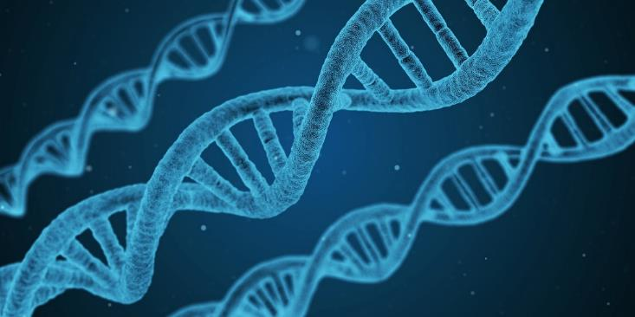
Genetic Algorithms (GAs)

Slide 11
Pseudocode of a Generic Genetic Algorithm
Representation
begin
generate initial population; // initialise
calculate fitness values; // evaluate population
do
{
perform reproduction; // select parents (mates)
recombine pairs with p_{c}; // apply crossover
apply mutation with p_{m}; // mutate offspring/children
calculate fitness values; // eval. population
replace current population;
} while termination criteria not satisfied;
end

Slide 12
Basic Components of GAs
A genetic representation (encoding) for candidate solutions (individuals) to the problem at hand
An initialisation scheme to generate the first population (set) of candidate solutions (individuals)
A fitness (evaluation) function that plays the role of the environment, rating the solutions in terms of their fitness
A scheme for selecting mates (parents) for recombination
Crossover (recombination) exchanges genetic material between mates producing offspring (children)
Mutation perturbs an individual creating a new one
Replacement strategy to select the surviving individuals for the next generation
Termination Criteria
Values for various parameters that GA uses (population size, probabilities of applying genetic operators, etc)
A genetic representation (encoding) for candidate solutions (individuals) to the problem at hand
An initialisation scheme to generate the first population (set) of candidate solutions (individuals)
A fitness (evaluation) function that plays the role of the environment, rating the solutions in terms of their fitness
A scheme for selecting mates (parents) for recombination
Crossover (recombination) exchanges genetic material between mates producing offspring (children)
Mutation perturbs an individual creating a new one
Replacement strategy to select the surviving individuals for the next generation
Termination Criteria
Values for various parameters that GA uses (population size, probabilities of applying genetic operators, etc)

Slide 13
Pseudocode of a Generic Genetic Algorithm
Representation
begin
generate initial population; // initialise
calculate fitness values; // evaluate population
do
{
perform reproduction; // select parents
recombine pairs with p_{c}; // apply crossover
apply mutation with p_{m}; // mutate offspring/children
calculate fitness values; // eval. population
replace current population;
} while termination criteria not satisfied;
end

Slide 14
GA Components: Representation
Haploid structure is used: Each individual contains one chromosome
Each individual is evaluated and has an associated fitness value
Chromosomes contain a fixed number of genes: chromosome length
Traditionally binary encoding is used for each gene: Allele value ∈ {0,1}
A population contains a fixed number of individuals: population size
Each iteration is referred to as generation
Haploid structure is used: Each individual contains one chromosome
Each individual is evaluated and has an associated fitness value
Chromosomes contain a fixed number of genes: chromosome length
Traditionally binary encoding is used for each gene: Allele value ∈ {0,1}
A population contains a fixed number of individuals: population size
Each iteration is referred to as generation

Slide 15
Pseudocode of a Generic Genetic Algorithm
Representation
begin
generate initial population; // initialise
calculate fitness values; // evaluate population
do
{
perform reproduction; // select parents
recombine pairs with p_{c}; // apply crossover
apply mutation with p_{m}; // mutate offspring/children
calculate fitness values; // eval. population
replace current population;
} while termination criteria not satisfied;
end

Slide 16
GA Components: Initialisation
Random Initialisation
Population size number of individuals are created randomly
Each gene at a locus of an individual is assigned an allele value 0 or 1 randomly, decided by flipping a coin (E.g., if the random value is <0.5, then allele is assigned to 0, otherwise to 1).
Random Initialisation
Population size number of individuals are created randomly
Each gene at a locus of an individual is assigned an allele value 0 or 1 randomly, decided by flipping a coin (E.g., if the random value is <0.5, then allele is assigned to 0, otherwise to 1).
Chromosome (individual)
gene
0
0
1
1
1
1
0
0
0
1
1
1
2
3
4
5
locus

Slide 17


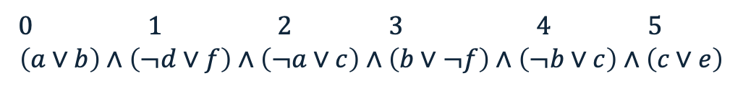



Example – MAX-SAT: Initialisation
0 1 2 3 4 5
$$\left(a∨b\right)∧\left(¬d∨f\right)∧\left(¬a∨c\right)∧\left(b∨¬f\right)∧\left(¬b∨c\right)∧\left(c∨e\right)$$
Assume population size is 4
The individual size/chromosome length is 6 (since we have 6 literals: abcdef)
So, create 4 individuals with 6 genes within their chromosomes, where each allele at a locus is determined randomly (by throwing a random number in [0,1)).
1: <0.98, 0.85, 0.13, 0.04, 0.47, 0.44>
2: <0.09, 0.63, 0.22, 0.54, 0.07, 0.37>
3: <0.21, 0.03, 0.72, 0.84, 0.19, 0.49>
4: <0.61, 0.43, 0.87, 0.53, 0.97, 0.14>
$$1$$
$$0$$
$$1$$
$$0$$
$$1$$
$$1$$

Slide 18
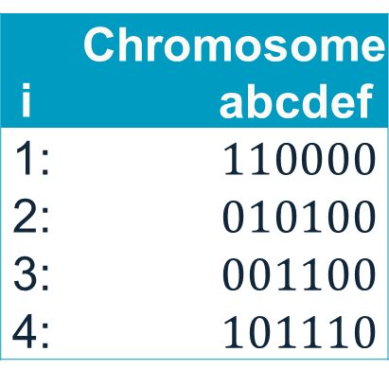
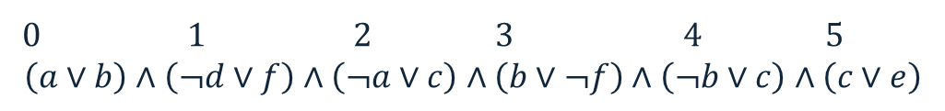
Example – MAX-SAT: Initialisation
0 1 2 3 4 5
$$\left(a∨b\right)∧\left(¬d∨f\right)∧\left(¬a∨c\right)∧\left(b∨¬f\right)∧\left(¬b∨c\right)∧\left(c∨e\right)$$
Assume population size is 4
The individual size/chromosome length is 6 (since we have 6 literals: abcdef)
So, create 4 individuals with 6 genes within their chromosomes, where each allele at a locus is determined randomly (by throwing a random number in [0,1)).
i | Chromosome abcdef .
1: | $$110000$$
2: | $$010100$$
3: | $$001100$$
4: | $$101110$$

Slide 19
Pseudocode of a Generic Genetic Algorithm
Representation
begin
generate initial population; // initialise
calculate fitness values; // evaluate population
do
{
perform reproduction; // select parents
recombine pairs with p_{c}; // apply crossover
apply mutation with p_{m}; // mutate offspring/children
calculate fitness values; // eval. population
replace current population;
} while termination criteria not satisfied;
end

Slide 20
GA Components – Fitness Calculation
Fitness value indicates
how fit the individual is to survive and reproduce under the current conditions
How much does the current solution meet the requirements of the objective function
Fitness value is obtained by applying the fitness function to the individual’s chromosome (candidate solution) – genotype (e.g., 101110) to phenotype (e.g., 1) mapping
Fitness value indicates
how fit the individual is to survive and reproduce under the current conditions
How much does the current solution meet the requirements of the objective function
Fitness value is obtained by applying the fitness function to the individual’s chromosome (candidate solution) – genotype (e.g., 101110) to phenotype (e.g., 1) mapping

Slide 21
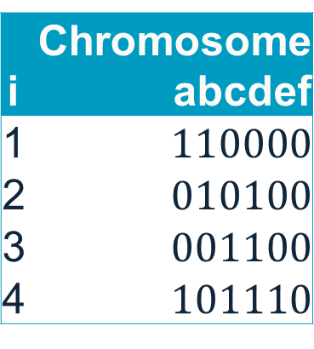
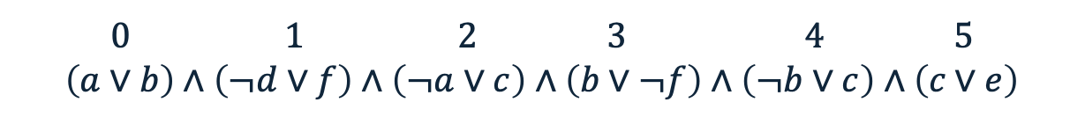
Example – MAX-SAT: Fitness Calculation
0 1 2 3 4 5
$$\left(a∨b\right)∧\left(¬d∨f\right)∧\left(¬a∨c\right)∧\left(b∨¬f\right)∧\left(¬b∨c\right)∧\left(c∨e\right)$$
i | Chromosome abcdef
1 | $$110000$$
2 | $$010100$$
3 | $$001100$$
4 | $$101110$$
Unsatisfied clauses | Fitness

Slide 22
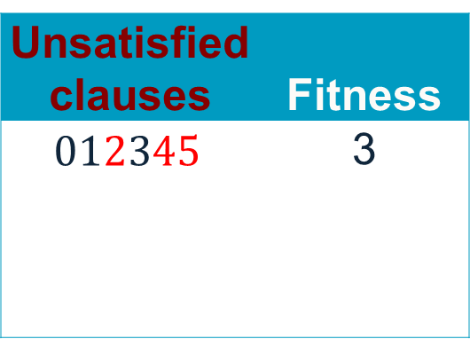
Example – MAX-SAT: Fitness Calculation
0 1 2 3 4 5
$$\left(a∨b\right)∧\left(¬d∨f\right)∧\left(¬a∨c\right)∧\left(b∨¬f\right)∧\left(¬b∨c\right)∧\left(c∨e\right)$$
i | Chromosome abcdef
1 | $$110000$$
2 | $$010100$$
3 | $$001100$$
4 | $$101110$$
Unsatisfied clauses | Fitness
$012345$ | 3

Slide 23
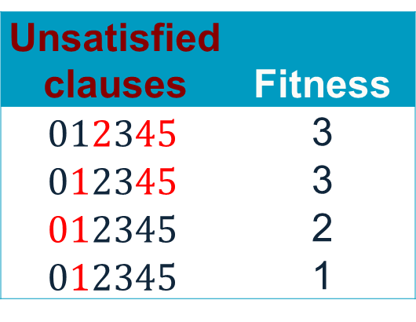
Example – MAX-SAT: Fitness Calculation
0 1 2 3 4 5
$$\left(a∨b\right)∧\left(¬d∨f\right)∧\left(¬a∨c\right)∧\left(b∨¬f\right)∧\left(¬b∨c\right)∧\left(c∨e\right)$$
i | Chromosome abcdef
1 | $$110000$$
2 | $$010100$$
3 | $$001100$$
4 | $$101110$$
Unsatisfied clauses | Fitness
$012345$ | 3
$012345$ | 3
$012345$ | 2
$012345$ | 1

Slide 24
Pseudocode of a Generic Genetic Algorithm
Representation
begin
generate initial population; // initialise
calculate fitness values; // evaluate population
do
{
perform reproduction; // select parents
recombine pairs with p_{c}; // apply crossover
apply mutation with p_{m}; // mutate offspring/children
calculate fitness values; // eval. population
replace current population;
} while termination criteria not satisfied;
end

Slide 25
GA Components – Reproduction
Reproduction (Mate Selection) consists of
selecting individuals: apply selection pressure considering the fitness of individuals in the population ⇒ e.g., roulette wheel selection, tournament selection, rank selection, truncation selection, Boltzmann selection, etc.
Selection pressure means that individuals with better fitness have a higher chance of being selected
usually 2 parents (individuals/candidate solutions) are selected using the same method, which will go under the crossover operation
Reproduction (Mate Selection) consists of
selecting individuals: apply selection pressure considering the fitness of individuals in the population ⇒ e.g., roulette wheel selection, tournament selection, rank selection, truncation selection, Boltzmann selection, etc.
Selection pressure means that individuals with better fitness have a higher chance of being selected
usually 2 parents (individuals/candidate solutions) are selected using the same method, which will go under the crossover operation

Slide 26
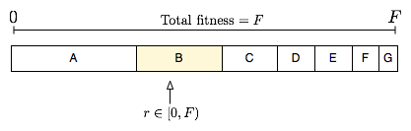
Fitness Proportionate Selection – Roulette Wheel Selection
Fitness level is used to associate a probability (prob_{i}) of selection with each individual chromosome (i)
While candidate solutions with a higher fitness will be less likely to be eliminated, there is still a chance that they may be (maximisation problem)
Expected number of representatives of each individual in the pool is proportional to its fitness (maximisation problem)
Fitness level is used to associate a probability (prob_{i}) of selection with each individual chromosome (i)
While candidate solutions with a higher fitness will be less likely to be eliminated, there is still a chance that they may be (maximisation problem)
Expected number of representatives of each individual in the pool is proportional to its fitness (maximisation problem)
maximisation problem
C
D
B
A
pop.size

Slide 27
Roulette Wheel Selection – Minimisation Problem
If you are dealing with a minimisation problem (where a lower score, like error or cost, is better), the standard formula fails, so the values should be transformed:
Subtraction Method (Windowing): fitness_{i} = cost_{max} − cost_{i} + ε
Reciprocal Method (Inversion): fitness_{i} = 1/(cost_{i} + ε)
Ranking (Rank-based) Method: Instead of using the raw values, you simply sort the population from best (lowest cost) to worst (highest cost)
Rank Cost (minimising) Assigned Fitness
1 0.081 (best) 20
2 3.095 19
… … …
20 123.1 (worst) 1
If you are dealing with a minimisation problem (where a lower score, like error or cost, is better), the standard formula fails, so the values should be transformed.
Subtraction Method (Windowing): fitness_{i} = cost_{max} − cost_{i} + ε
Reciprocal Method (Inversion): fitness_{i} = 1/(cost_{i} + ε)
Ranking (Rank-based) Method: Instead of using the raw values, you simply sort the population from best (lowest cost) to worst (highest cost)
Rank Cost (minimising) Assigned Fitness
1 0.081 (best) 20
2 3.095 19
… … …
20 123.1 (worst) 1

Slide 28
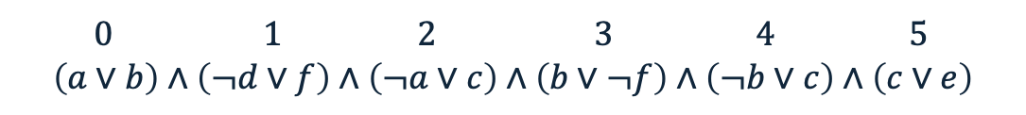
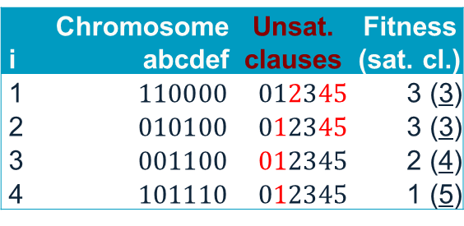
Example: MAX-SAT – Roulette Wheel Selection
fitness_{i} = cost_{max} − cost_{i}
0 1 2 3 4 5
$$\left(a∨b\right)∧\left(¬d∨f\right)∧\left(¬a∨c\right)∧\left(b∨¬f\right)∧\left(¬b∨c\right)∧\left(c∨e\right)$$
prob_{i}
20%
20%
27%
33%
i | Chromosome abcdef | Unsat. clauses | Fitness (sat. cl.)
1 | $$110000$$ | $012345$ | 3 (3)
2 | $$010100$$ | $012345$ | 3 (3)
3 | $$001100$$ | $012345$ | 2 (4)
4 | $$101110$$ | $012345$ | 1 (5)
prob_{i}
Rotate the wheel
fittest individual
1
4
total:(15)
Selection point
2
Random#2
0.12
Random#1
0.84
3
0
0.33
0.53
0.73
1
4
1
2
3
Random#1: 0.84 → Parent#1: 3
Random#2: 0.12 → Parent#2: 4

Slide 29
Early Module Feedback
Please fill in the early module feedback to include lectures and computing labs – be constructive, responses are anonymous! 🙂

Slide 30
Tournament Selection
This method involves running a number of "tournaments" among randomly chosen individuals (of tour size) selecting the one with best fitness at the end
This process is repeated for selecting each parent to be recombined

Slide 31
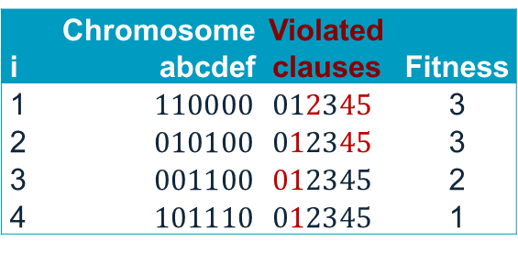
Example – MAX-SAT: Tournament Selection
tour size = 3, first parent
Throw a random number between 1 and 4 (population size) for 3 times:
[3, 1, 2]
Tournament selection chooses 3 individuals: #1, #2 and #3 at random, then individual#3 with the fitness of 2 is returned as the first parent
i | Chromosome abcdef | Violated clauses | Fitness
1 | $$110000$$ | $012345$ | 3
2 | $$010100$$ | $012345$ | 3
3 | $$001100$$ | $012345$ | 2
4 | $$101110$$ | $012345$ | 1

Slide 32
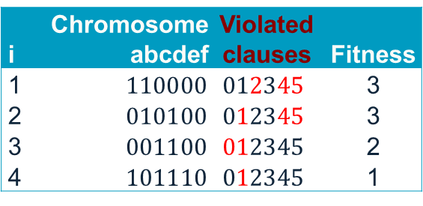
Example – MAX-SAT: Tournament Selection
tour size = 3, second parent
Throw a random number between 1 and 4 (population size) for 3 times:
[4, 1, 3]
Tournament selection chooses 3 individuals: #1, #3 and #4 at random, then individual#4 with the fitness of 1 is returned as the second parent
Throw a random number between 1 and 4 (population size) for 3 times:
[4, 1, 3]
Tournament selection chooses 3 individuals: #1, #3 and #4 at random, then individual#4 with the fitness of 1 is returned as the second parent
i | Chromosome abcdef | Violated clauses | Fitness
1 | $$110000$$ | $012345$ | 3
2 | $$010100$$ | $012345$ | 3
3 | $$001100$$ | $012345$ | 2
4 | $$101110$$ | $012345$ | 1

Slide 33
Pseudocode of a Generic Genetic Algorithm
Representation
begin
generate initial population; // initialise
calculate fitness values; // evaluate population
do
{
perform reproduction; // select parents
recombine pairs with p_{c}; // apply crossover
apply mutation with p_{m}; // mutate offspring/children
calculate fitness values; // eval. population
replace current population;
} while termination criteria not satisfied;
end

Slide 34
Recombination – Crossover
Selected pairs/mates (parents) are recombined to form new individuals (candidate solutions/children/offspring) – exchange of genetic material
Crossover is applied with a crossover probability p_{c} which in general is chosen close to 1.0
One Point Crossover (1PTX)
Generate a random number in [0,1), if it is smaller than a crossover probability p_{c} Then
Select a random crossover site in [1,choromosome length]
Split individuals at the selected site
Exchange segments between pairs to form two new individuals
Else
Copy the individuals as new individuals
Selected pairs/mates (parents) are recombined to form new individuals (candidate solutions/children/offspring) – exchange of genetic material
Crossover is applied with a crossover probability p_{c} which in general is chosen close to 1.0
One Point Crossover (1PTX)
Generate a random number in [0,1), if it is smaller than a crossover probability p_{c} Then
Select a random crossover site in [1,choromosome length]
Split individuals at the selected site
Exchange segments between pairs to form two new individuals
Else
Copy the individuals as new individuals

Slide 35
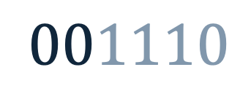
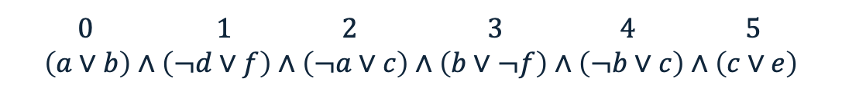
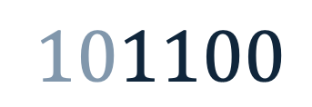
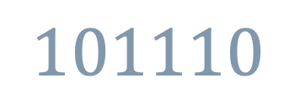
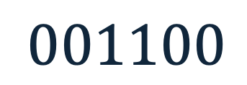
Example – MAX-SAT: 1PTX
0 1 2 3 4 5
$$\left(a∨b\right)∧\left(¬d∨f\right)∧\left(¬a∨c\right)∧\left(b∨¬f\right)∧\left(¬b∨c\right)∧\left(c∨e\right)$$
Random number: 2
Randomly determined crossover point
$$001100$$
$$101100$$
2. Exchange the genetic material
$$101110$$
$$001110$$
Select the crossover site by throwing a random number in…?
new solutions/children/offspring

Slide 36
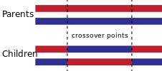
Other Crossover Operators
2 Point Crossover (2PTX) K-point Crossover Uniform Crossover (UX)
The uniform crossover considers each bit in the parent strings for exchange with a probability of 0.5.
0
0
1
0
1
1
0
1
1
0
0
1
Random Number
0.23 0.76 0.15 0.34 0.91 0.48
1
1
1
0
0
0
1
0
1
0
1
0

Slide 37
Pseudocode of a Generic Genetic Algorithm
Representation
begin
generate initial population; // initialise
calculate fitness values; // evaluate population
do
{
perform reproduction; // select parents
recombine pairs with p_{c}; // apply crossover
apply mutation with p_{m}; // mutate offspring/children
calculate fitness values; // eval. population
replace current population;
} while termination criteria not satisfied;
end

Slide 38
Mutation
Any offspring might be exposed to mutation
Loop through all the alleles of all the individuals one by one, and if that allele is selected for mutation with a given probability p_{m}, you can either change it by a small amount or replace it with a new value
For binary representation mutation corresponds to flipping a selected gene value (0→1, 1→0)
Mutation provides diversity and allows GA to explore different regions of the search space (escaping)
Mutation rate is typically chosen to be very small (0.001, 0.001). Choosing p_{m} as (1/chromosome length) implies on average a single gene will be mutated for an individual.
Any offspring might be exposed to mutation
Loop through all the alleles of all the individuals one by one, and if that allele is selected for mutation with a given probability p_{m}, you can either change it by a small amount or replace it with a new value
For binary representation mutation corresponds to flipping a selected gene value (0→1, 1→0)
Mutation provides diversity and allows GA to explore different regions of the search space (escaping)
Mutation rate is typically chosen to be very small (0.001, 0.001). Choosing p_{m} as (1/chromosome length) implies on average a single gene will be mutated for an individual.

Slide 39
Example – Mutation
1
0
1
1
0
0
A loop is performed on each individual
If a random value in [0,1) is < p_{m} =0.17 (1/6), then the allele value is flipped, otherwise kept same.
0
0
1
1
1
0

Slide 40
Example – Mutation
Random numbers:
<0.23 0.76 0.41 0.14 0.91 0.68 0.47 0.16 0.28 0.94 0.78 0.03 …>
0.23
0.76
0.41
0.14
0.91
0.68
1
0
1
0
1
0
0
A loop is performed on each individual
If a random value in [0,1) is < p_{m} =0.17 (1/6), then the allele value is flipped, otherwise kept same.
0.47
0.16
0.28
0.94
0.78
0.03
0
1
0
1
1
1
0
1

Slide 41
Pseudocode of a Generic Genetic Algorithm
Representation
begin
generate initial population; // initialise
calculate fitness values; // evaluate population
do
{
perform reproduction; // select parents
recombine pairs with p_{c}; // apply crossover
apply mutation with p_{m}; // mutate offspring/children
calculate fitness values; // eval. population
replace current population;
} while termination criteria not satisfied;
end

Slide 42
Replacement Strategy
There are variety of strategies for replacing the old population (generation) by the new (offspring) population to form the next generation
Generation gap (α) controls the fraction of the population to be replaced in each generation, where α ∈ [1/N,1.0]
Number of offspring produced at each generation is g=α*N
(Trans-)Generational GA (g>2, that is α>2/N)
N individuals produce αN offspring, so (N + αN) → N
αN replaces worst αN of N
largest generation gap where α=1.0 yields g=N.
GA relies on improvement of average objective values from one population to another
It is always a good idea not to loose the best solution found so far.
sort (N + αN) and choose the N best (elitism)
There are variety of strategies for replacing the old population (generation) by the new (offspring) population to form the next generation
Generation gap (α) controls the fraction of the population to be replaced in each generation, where α ∈ [1/N,1.0]
Number of offspring produced at each generation is g=α*N
(Trans-)Generational GA (g>2, that is α>2/N)
N individuals produce αN offspring, so (N + αN) → N
αN replaces worst αN of N
largest generation gap where α=1.0 yields g=N.
GA relies on improvement of average objective values from one population to another
It is always a good idea not to loose the best solution found so far.
sort (N + αN) and choose the N best (elitism)

Slide 43
Replacement Strategy
Steady-State GA (g=2, that is α=2/N)
Two offspring replace two individuals from the old generation.
Method#1: two offspring replace two parents
Method#2: two offspring replace worst two of the population
Method#3: best two of (parents and offspring) replace two parents (elitism)
Method#4: best two of (parents and offspring) replace worst two of the population (strong elitism)
What methods can be used?

Slide 44
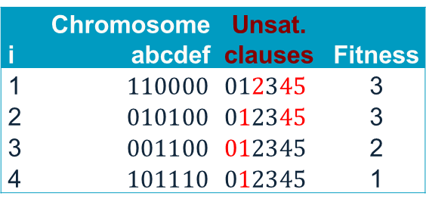
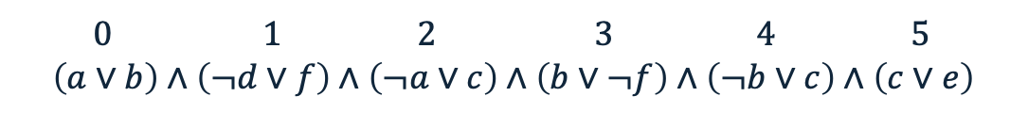
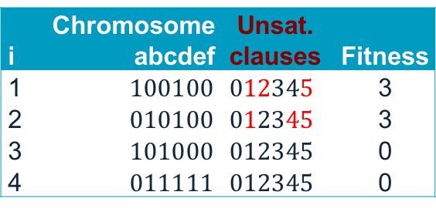

Example – Transgenerational GA Replacement (no elitism)
0 1 2 3 4 5
$$\left(a∨b\right)∧\left(¬d∨f\right)∧\left(¬a∨c\right)∧\left(b∨¬f\right)∧\left(¬b∨c\right)∧\left(c∨e\right)$$
Form the new generation by
i | Chromosome abcdef | Unsat. clauses | Fitness
1 | $$100100$$ | $012345$ | 3
2 | $$010100$$ | $012345$ | 3
3 | $$101000$$ | $012345$ | 0
4 | $$011111$$ | $012345$ | 0
copying offspring onto the old population, forming the new population
(g=N=4)
i | Chromosome abcdef | Unsat. clauses | Fitness
1 | $$100100$$ | $012345$ | 3
2 | $$010100$$ | $012345$ | 3
3 | $$101000$$ | $012345$ | 0
4 | $$011111$$ | $012345$ | 0
Offspring
i | Chromosome abcdef | Unsat. clauses | Fitness
1 | $$110000$$ | $012345$ | 3
2 | $$010100$$ | $012345$ | 3
3 | $$001100$$ | $012345$ | 2
4 | $$101110$$ | $012345$ | 1
New Population/ Generation
Old Population
44

Slide 45
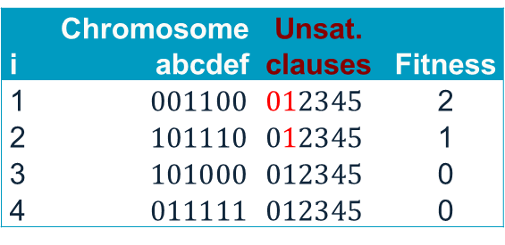
Example – TGA Replacement (with elitism)
0 1 2 3 4 5
$$\left(a∨b\right)∧\left(¬d∨f\right)∧\left(¬a∨c\right)∧\left(b∨¬f\right)∧\left(¬b∨c\right)∧\left(c∨e\right)$$
Form the new generation by
i | Chromosome abcdef | Unsat. clauses | Fitness
1 | $$100100$$ | $012345$ | 3
2 | $$010100$$ | $012345$ | 3
3 | $$101000$$ | $012345$ | 0
4 | $$011111$$ | $012345$ | 0
Selecting the best 4 individuals among both old population and offspring
(g=N=4)
i | Chromosome abcdef | Unsat. clauses | Fitness
1 | $$001100$$ | $012345$ | 2
2 | $$101110$$ | $012345$ | 1
3 | $$101000$$ | $012345$ | 0
4 | $$011111$$ | $012345$ | 0
Offspring
i | Chromosome abcdef | Unsat. clauses | Fitness
1 | $$110000$$ | $012345$ | 3
2 | $$010100$$ | $012345$ | 3
3 | $$001100$$ | $012345$ | 2
4 | $$101110$$ | $012345$ | 1
New Population/ Generation
Old Population

Slide 46
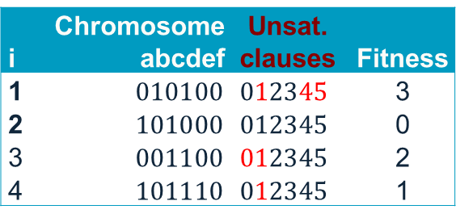
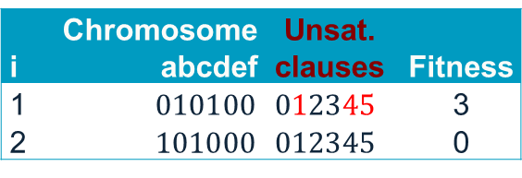
Example – A Steady State GA (with elitism)
0 1 2 3 4 5
$$\left(a∨b\right)∧\left(¬d∨f\right)∧\left(¬a∨c\right)∧\left(b∨¬f\right)∧\left(¬b∨c\right)∧\left(c∨e\right)$$
Next generation
i | Chromosome abcdef | Unsat. clauses | Fitness
1 | $$010100$$ | $012345$ | 3
2 | $$101000$$ | $012345$ | 0
Using Method#2: Replace the worst 2 of the population with 2 offspring (g=2)
Offspring
i | Chromosome abcdef | Unsat. clauses | Fitness
1 | $$010100$$ | $012345$ | 3
2 | $$101000$$ | $012345$ | 0
3 | $$001100$$ | $012345$ | 2
4 | $$101110$$ | $012345$ | 1
i | Chromosome abcdef | Unsat. clauses | Fitness
1 | $$110000$$ | $012345$ | 3
2 | $$010100$$ | $012345$ | 3
3 | $$001100$$ | $012345$ | 2
4 | $$101110$$ | $012345$ | 1
New Population/ Generation
Old Population
46

Slide 47
Pseudocode of a Generic Genetic Algorithm
Representation
begin
generate initial population; // initialise
calculate fitness values; // evaluate population
do
{
perform reproduction; // select parents
recombine pairs with p_{c}; // apply crossover
apply mutation with p_{m}; // mutate offspring/children
calculate fitness values; // eval. population
replace current population;
} while termination criteria not satisfied;
end

Slide 48
Termination Criteria
The evolution (main loop) continues until a termination criteria is met, possibly until:
A predefined maximum number of generations is exceeded
A goal is reached, for example:
Expected fitness is achieved
Population converges
Best fitness does not change for a while
A condition is satisfied depending on a combination of above
The evolution (main loop) continues until a termination criteria is met, possibly until:
A predefined maximum number of generations is exceeded
A goal is reached, for example:
Expected fitness is achieved
Population converges
Best fitness does not change for a while
A condition is satisfied depending on a combination of above

Slide 49
Convergence
Defined as the progression towards uniformity (individuals become alike)
Gene convergence: a location on a chromosome is converged when 95% of the individuals have the same gene value for that location
Population (Genotypic) convergence: a population is converged when all the genes have converged (all individuals are alike – they might have different fitness)
Phenotypic Convergence: average fitness of the population approaches to the best individual in the population (all individuals have the same fitness)
Defined as the progression towards uniformity (individuals become alike)
Gene convergence: a location on a chromosome is converged when 95% of the individuals have the same gene value for that location
Population (Genotypic) convergence: a population is converged when all the genes have converged (all individuals are alike – they might have different fitness)
Phenotypic Convergence: average fitness of the population approaches to the best individual in the population (all individuals have the same fitness)

Slide 50
Key Features of EAs
Population based search approaches
Be independent of initial starting point(s)
Start search from many points in the search space
Conduct search in parallel over the search space
implicit parallelism
Avoid converging to local optima
Balances exploration and exploitation?
May be used together with other approaches (hybrids)
Population based search approaches
Be independent of initial starting point(s)
Start search from many points in the search space
Conduct search in parallel over the search space
implicit parallelism
Avoid converging to local optima
Balances exploration and exploitation?
May be used together with other approaches (hybrids)

Slide 51
Memetic Algorithms (MAs)

Slide 52
Memetic Algorithms (MAs)
Meme (Richard Dawkins): contagious piece of information
Memes are similar to local refinement/local search
Gene vs meme: Memes can change, evolve using rules and time scales other than the traditional genetic ones
MAs aim to improve GAs by embedding local search
Meme (Richard Dawkins): contagious piece of information
Memes are similar to local refinement/local search
Gene vs meme: Memes can change, evolve using rules and time scales other than the traditional genetic ones
MAs aim to improve GAs by embedding local search

Slide 53
Memetic Algorithms (MAs) II
MAs make use of exploration capabilities of GAs and exploitation capabilities of local search
MAs have an explicit mechanism to balance exploitation and exploration
Memetic Algorithms shown to be much faster and more accurate than GAs on some problems, and are the “state of the art” on many problems
MAs make use of exploration capabilities of GAs and exploitation capabilities of local search
MAs have an explicit mechanism to balance exploitation and exploration
Memetic Algorithms shown to be much faster and more accurate than GAs on some problems, and are the “state of the art” on many problems

Slide 54
Pseudocode of a Generic Genetic Algorithm
Representation
begin
generate initial population; // initialise
calculate fitness values; // evaluate population
do
{
perform reproduction; // select parents
recombine pairs with p_{c}; // apply crossover
apply mutation with p_{m}; // mutate offspring/children
calculate fitness values; // eval. population
replace current population;
} while termination criteria not satisfied;
end

Slide 55
Pseudocode of a Generic Memetic Algorithm
Representation
begin
generate initial population; // initialise
calculate fitness values; // evaluate population
do
{
perform reproduction; // select parents
recombine pairs with p_{c}; // apply crossover
apply mutation with p_{m}; // mutate offspring/children
apply local search; // hill climbing on offspring
calculate fitness values; // eval. population
replace current population;
} while termination criteria not satisfied;
end

Slide 56
A Generic Memetic Algorithm (MA)
15.0
Generate Initial Population
28.0
7.0
Evaluate All Individuals
9.0
7.0
Select Parents
9.0
no
Terminate?
yes
Crossover
Mutate
16.0
11.0
Evaluate All Children
6.0
Hill Climbing
10.0
6.0
Form Next Generation
7.0
9.0
10.0

Slide 57
Pseudocode of a Generic Memetic Algorithm
Moscato, P.: On evolution, search, optimization, genetic algorithms and martial arts: Towards memetic algorithms, Caltech Concurrent Computation Program Report 826, California Institute of Technology (1989)
Representation
begin
generate initial population; // initialise
calculate fitness values; // evaluate population
do
{
perform reproduction; // select parents
recombine pairs with p_{c}; // apply crossover
apply mutation with p_{m}; // mutate offspring/children
apply hill climbing; // local search on offspring
calculate fitness values; // eval. population
replace current population;
} while termination criteria not satisfied;
end

Slide 58
Example – Designing a Genetic/Memetic Algorithm for MAX-SAT
Representation: Bit string of length N (truth assignment for each variable)
Initialisation: Randomly generate initial population, population size=N
Fitness function: (# of clauses – C); # of unsatisfied clauses
Mate selection: Tournament selection with a tour size of 2
Crossover: 1PTX, crossover probability = 0.99
Mutation: random bit-flip, mutation probability = 1/N
Hill Climbing: Davis’s Bit Hill Climbing
Replacement: Steady State GA, best two of (parents and offspring) replaces the worst two individuals in the population (strong elitism)

Slide 59
Example – Designing a Genetic/Memetic Algorithm for MAX-SAT: Initilisation
Initial
Population
110000
010100
001100
101110
Genetic Algorithm Steps:
Memetic Algorithm Steps:
Initialisation:
Population is already given, so we skip random initialisation.
Initialisation:
Population is already given, so we skip random initialisation.

Slide 60
Example – Designing a Genetic/Memetic Algorithm for MAX-SAT: Evaluation
Initial
Population
110000
010100
001100
101110
Genetic Algorithm Steps:
Memetic Algorithm Steps:
Fitness Evaluation:
110000 (Fitness: 3)
010100 (Fitness: 6)
001100 (Fitness: 5)
101110 (Fitness: 5)
Fitness Evaluation:
110000 (Fitness: 3)
010100 (Fitness: 6)
001100 (Fitness: 5)
101110 (Fitness: 5)

Slide 61
Example – Designing a Genetic/Memetic Algorithm for MAX-SAT: Parent Selection
Initial
Population
110000
010100
001100
101110
Genetic Algorithm Steps:
Memetic Algorithm Steps:
Selection:
Use tournament selection (size 2) to choose parents.
Example: Select (010100, Fitness 6) and (001100, Fitness 5)
Selection:
Use tournament selection (size 2) to choose parents.
Example: Select (010100, Fitness 6) and (001100, Fitness 5)

Slide 62
Example – Designing a Genetic/Memetic Algorithm for MAX-SAT
Initial
Population
110000
010100
001100
101110
Genetic Algorithm Steps:
Memetic Algorithm Steps:
Crossover:
Use single-point crossover.
Crossover:
Use single-point crossover.
Parents | After Crossover
010|100 | 010100
001|100 | 001100
Parents | After Crossover
010|100 | 010100
001|100 | 001100

Slide 63
Example – Designing a Genetic/Memetic Algorithm for MAX-SAT: Mutation
Initial
Population
110000
010100
001100
101110
Genetic Algorithm Steps:
Memetic Algorithm Steps:
Mutation:
Apply bit-flip mutation with a low probability (e.g., 1%).
Example: 010100 -> 011100 (3rd bit flipped)
001100 remains unchanged
Mutation:
Apply bit-flip mutation with a low probability (e.g., 1%).
Example: 010100 -> 011100 (3rd bit flipped)
001100 remains unchanged

Slide 64
Example – Designing a Genetic/Memetic Algorithm for MAX-SAT: Initialisation
Initial
Population
110000
010100
001100
101110
Genetic Algorithm Steps:
Memetic Algorithm Steps:
Local Search (Hill Climbing):
Apply to each offspring.
For 011100: 011100 (Fitness: 5)
111100 (F:4, revert) -> 011100
001100 (F:5, no change) -> 011100
010100 (F:6, keep) -> 010100
010000 (F:4, revert) -> 010100
010110 (F:5, revert) -> 010100
010101 (F:5, revert) -> 010100
Final: 010100 (Fitness: 6)
For 001100: Start: 001100 (Fitness: 5) (Similar process, no improvement found) Final: 001100 (Fitness: 5)
Fitness Evaluation of Offspring:
011100 (Fitness: 5)
001100 (Fitness: 5)

Slide 65
Example – Designing a Genetic/Memetic Algorithm for MAX-SAT: Local Search
Initial
Population
110000
010100
001100
101110
Genetic Algorithm Steps:
Memetic Algorithm Steps:
Fitness Evaluation of Offspring:
011100 (Fitness: 5)
001100 (Fitness: 5)
Local Search (Hill Climbing):
010100 (Fitness: 6)
001100 ((Fitness: 5)

Slide 66
Example – Designing a Genetic/Memetic Algorithm for MAX-SAT: Replacement
Initial
Population
110000
010100
001100
101110
Genetic Algorithm Steps:
Memetic Algorithm Steps:
Replace the two worst individuals in the population.
New population:
010100 (Fitness: 6) Original best
011100 (Fitness: 5) New offspring
001100 (Fitness: 5) New offspring
101110 (Fitness: 5) Retained from original population
Replace the two worst individuals in the population.
New population:
010100 (Fitness: 6) Original best
010100 (Fitness: 6) Improved offspring
001100 (Fitness: 5) Unchanged offspring
101110 (Fitness: 5) Retained from original population

Slide 67
Summary
Evolutionary Algorithms
Genetic Algorithms (GAs)
Memetic Algorithms (MAs)

Slide 68
Thank you Any questions?

